Slide 1

Possible sentence starters:
Pour aller au parc, …………….
Pour aller au restaurant, ………..
Pour aller à la plage, …………
Assessing Primary Languages Write phrases from memory – Stage 3
© Lara Townsend, Tracy Davies and Brilliant Publications Limited Pupil resource 1

Slide 2
Assessing Primary Languages Write phrases from memory – Stage 3
© Lara Townsend, Tracy Davies and Brilliant Publications Limited Pupil resource 2

Slide 3
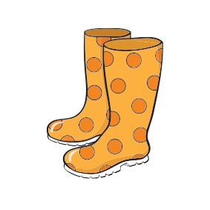

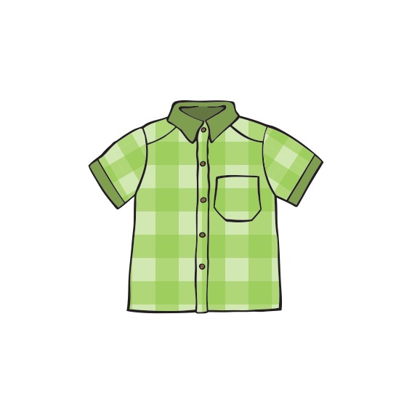
Assessing Primary Languages Write phrases from memory – Stage 3
© Lara Townsend, Tracy Davies and Brilliant Publications Limited Pupil resource 3

Slide 4
Additional Support
ou
parfois
avec
aussi
quand
froid
chaud
blanc/blanche
marron
ou
parfois
avec
aussi
quand
froid
chaud
blanc/blanche
marron
Assessing Primary Languages Write phrases from memory – Stage 3
© Lara Townsend, Tracy Davies and Brilliant Publications Limited Pupil resource 4

